Slide 1
Batch 13
Phase 2 Project Presentation
PROJECT TEAM:
K.CHANDRIKA-18BTRCI024
T.KRISHNA MOHAN REDDY-18BTRCI047
MANEESH REDDY-18BTRCI019

Slide 2
DIABETIC RETINOPATHY DETECTION
-A model to detect Diabetic Retinopathy

Slide 3
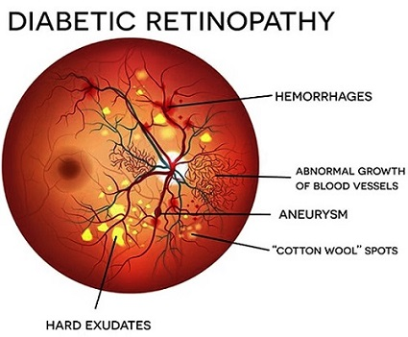
ABSTRACT:
Detection of Daibetic Retinopathy: Diabetic retinopathy is a diabetes complication that affects eyes. It's caused by damage to the blood vessels of the light-sensitive tissue at the back of the eye (retina). At first, diabetic retinopathy might cause no symptoms or only mild vision problems.Risk Factors: Diabetes; Tobacco smoking Diseases or conditions caused: Blindness.

Slide 4
TECHNOLOGIES USED
WEB APPLICATION
-HTML
-CSS
-BOOTSTRAP
-JAVASCRIPT
TECHNIQUES FOR ML MODEL
-TENSOR FLOW
-KERAS
-CONVOLUTIONAL NEURAL NETWORK
-DEEP LEARNING
THE WEB APPLICATION WILL BE DEPLOYED USING FLASK AND ANDROID APPLICATION WILL BE DEPLOYED USING GOOGLE’S FIREBASE

Slide 5
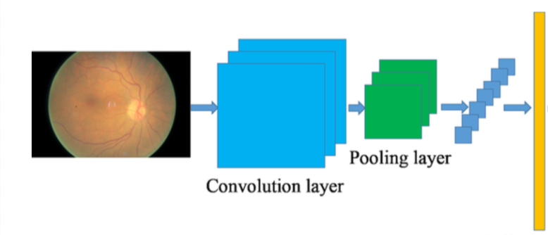
MODEL ARCHITECTURE
Fully connected layer

Slide 6
WORK ACCOMPLISHED

Slide 7
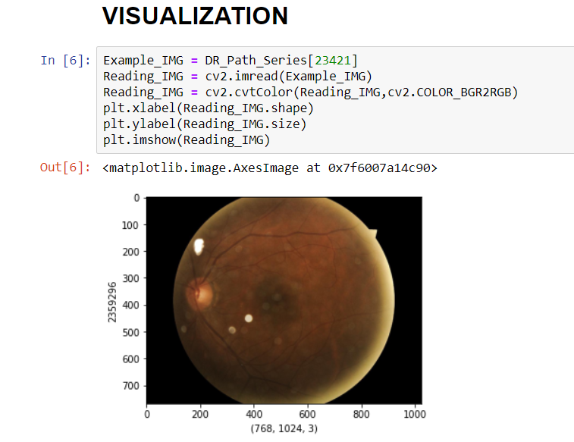
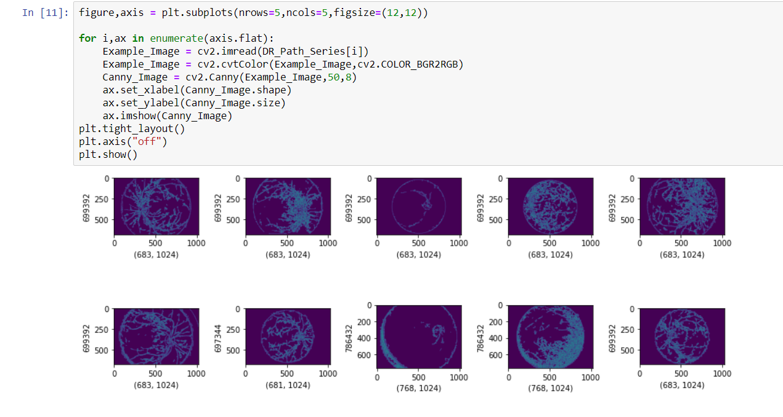
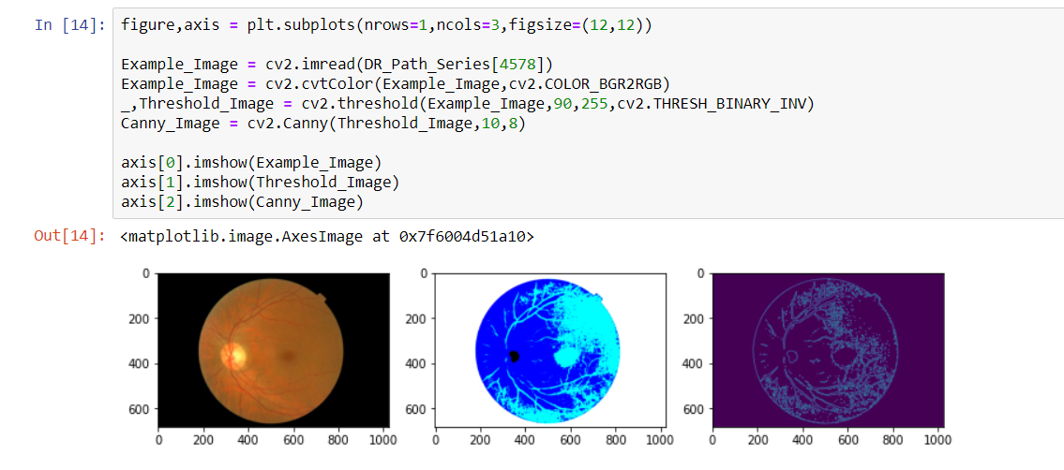
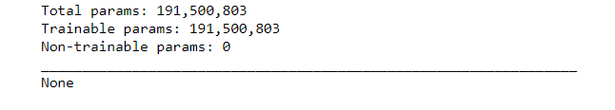
Example image
Threshold image
Canny image

Slide 8
MOTIVE AND OBJECTIVE:
-The motive of this project is to detect diabetic retinopathy in early stages
- CNN approach for diagnosing this from digital fundus image dataset from Kaggle and classifying its severity.
-The objective of this project is to enable doctors to view variations in the fundus images with the help of image preprocessing techniques.

Slide 9
USES:
-TIME SAVING PROCESS
-IMPROVED EFFICIENCY BY REDUCING HUMAN ERRORS
-COST EFFECTIVE AND EASILY MANAGEABLE

Slide 10
REFERENCE PAPERS

Slide 11
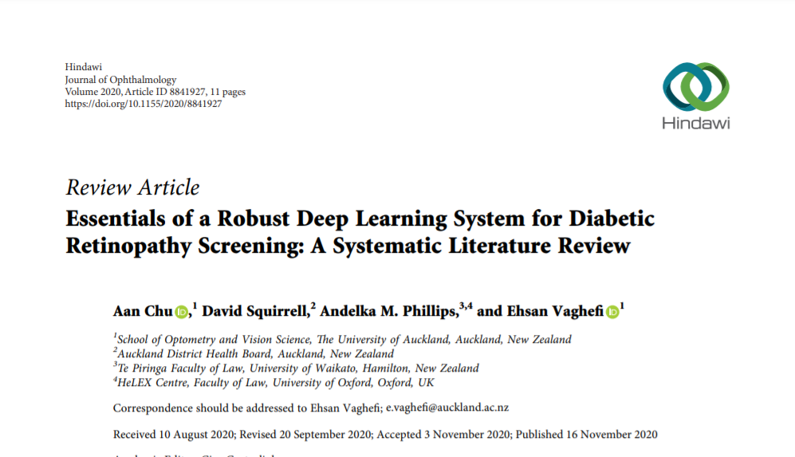

Slide 12
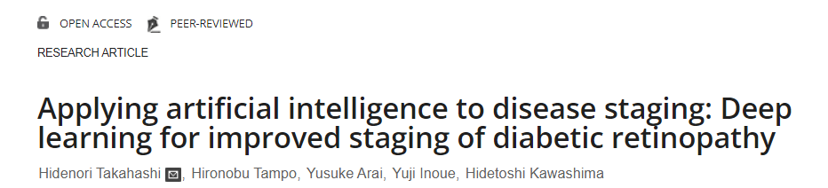
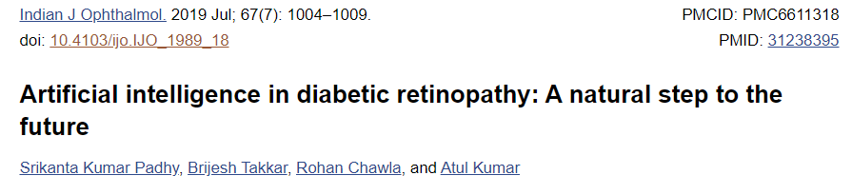

Slide 13
THANK YOU!

